Slide 1
Real Time Face Orientation Recognition on web-based platform
Faculty of Science and Technology, Dept. of Computer Science
Undergraduate thesis
Student Name | ID | Contribution
1. MD. ASIFUR RAHMAN | 18-38113-2
2. TASIN ISLAM | 17-34598-2
3. SM BAKIBILLAH LEMON | 18-38101-2
4. SHAHNAZ ALAM | 17-35531-3
Supervisor: | Sazzad Hossain Assistant Professor, Department of Computer Science

Slide 2
Content
Problem definition
Motivation
Literature Review
Research Questions
Methodology
Result & Synthesis
Future Work
References

Slide 3
Problem definition
Massive use of online meeting platform, but no tool for tracking the activity
Lack of attentiveness due to no monitoring
Increases the tendency of following wrong way in online viva time
No tool to track the facial movement
Difficult to observe everyone in online class

Slide 4
Motivation
Build a web-based tool to track the facial movement
Discover a way to track the facial movement
Reduce the tendency of following the wrong way during online exam
Provide a solid online meeting monitoring system

Slide 5
Literature Review
Yaun et al. (2017) conducted a research on face detection using CNN and SVM for face detction in complex environment with 87% of accuracy.
A low-level network model “inception-v3 model” was used by Xia et al (2017) to conduct a research on facial recognition. The research showed 97% accuracy which is higher than any other low-level network model
Shah et al. (2019) conducted a study by using a mathematical technique, Deep Neural Network and Haar Cascade method to find six facial points and determine the Euler angles of the face for face orientation detection
Wang et al. (2020) proposed an artificial fish swarm algorithm for face orientation recognition with the BP neural network to improve the accuracy than standard artificial fish swarm algorithm
Region-based Convolution Neural Network with body orientation, boundary, and occlusion condition was used by Zhang et al. (2019) for multi-people pose estimation with 84.6% accuracy of correct keypoints detection and 83.7% accuracy of correct detection

Slide 6
Literature Review
Gupta et al. (2017) proposed a image mapping method with feature extraction from the data of facial features to track and recognize facial expressions
Gao & Xu (2012) provides a new strategy for improving the efficiency and accuracy of face orientation detection by merging numerous feature triangles with a BP neural network indicating a success rate of 90%
Merrouche et al. (2017) offered a unique vision-based fall detection approach employing a depth camera that validated falls by combining human form analysis, head tracking, and centroid identification with up to 93.25% accuracy
A feature Inflation-Deflation module (I/DeF module) was presented as an extra module added ahead of the CNNs' input layer to assist feature learning of the head-movement dynamics by Takeda & Otsuka (2021) and compared to these approaches, I/DeF-CNNs outperformed the other models in 8 out of 10 functions

Slide 7
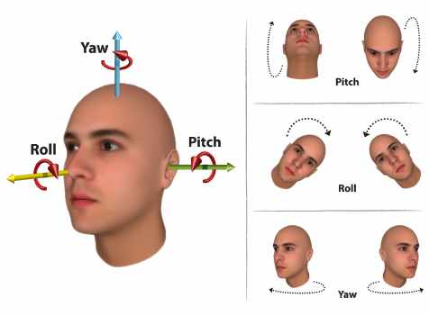
Research Questions
RQ1: How to understand the face movement?
When human face moves towards right or left, it creates a rotational angle with Y axis
when human face moves towards up or down, it creates a rotational angle with x axis.
Fig 1: Human face Movement

Slide 8
Research Methodology
followed Design Science Research Methodology.
Used Systematic Literature Review for Data collection
Collected articles using automated keyword search and manual search
Collected articles from digital library
Worked as pair for reviewing paper
Designed and developed the system using basic html and CSS and TensorFlow.js (facemesh) pre trained model and three.js library
Ran the system in all possible setting to observe the output
Tried to create scenario to observe the failure point

Slide 9
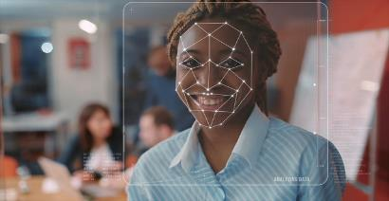
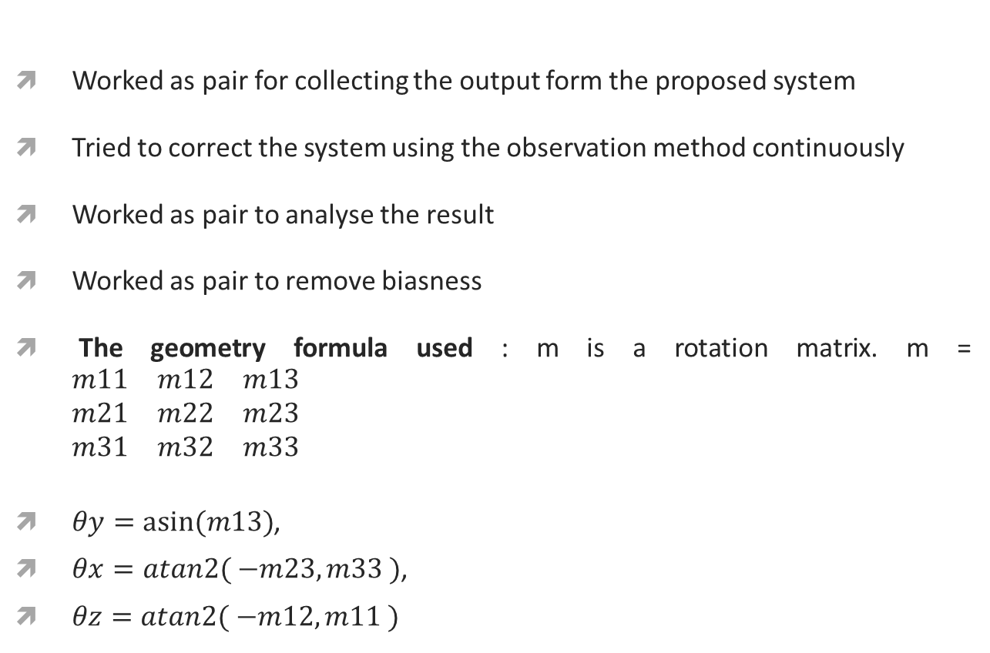
Research Methodology
Worked as pair for collecting the output form the proposed system
Tried to correct the system using the observation method continuously
Worked as pair to analyse the result
Worked as pair to remove biasness
The geometry formula used : m is a rotation matrix. m = $\begin{matrix}m11 & m12 & m13 \\ m21 & m22 & m23 \\ m31 & m32 & m33\end{matrix}$
$θy=asin⁡(m13)$,
$θx=atan2( −m23, m33 )$,
$θz=atan2( −m12, m11 )$

Slide 10
Result & Synthesis
Ran the proposed web-based face orientation detection solution from different seating position, different camera to face distance and different lighting condition
Observed a result with 95% forward, 90% left, 87% right, 91% up, and 83% down detection accuracy from 2 feet distance, different seating position, different window size and minimum face detecting lighting condition
Table 1: Break down of the analysis of the result from 2 feet distance, different seating position,
different window size and minimum face detecting lighting condition
Side | Actual | Solution output | Accuracy
Forward | 100 times | 95 times | 95%
Right | 100 times | 87 times | 87%
Left | 100 times | 90 times | 90%
Up | 100 times | 91 times | 91%
Down | 100 times | 83 time | 83%

Slide 11
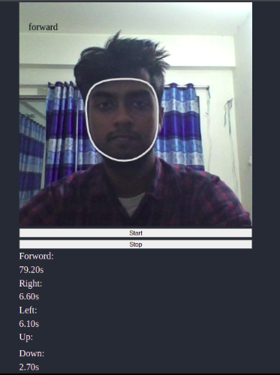
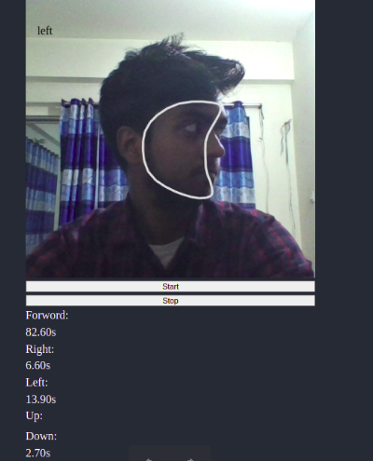
Result & Synthesis
Fig 2: Forward face detection from 2 feet distance of different people
Fig 3: Left face detection from 2 feet distance of different people

Slide 12
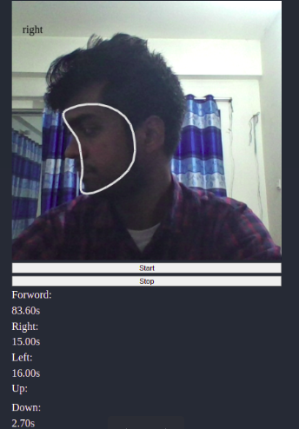
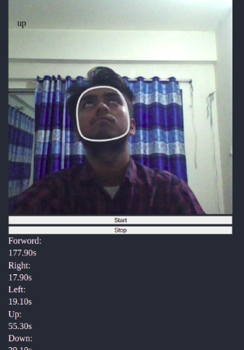
Result & Synthesis
Fig 4: Right face detection from 2 feet distance of different people
Fig 5: Up face detection from 2 feet distance of different people

Slide 13
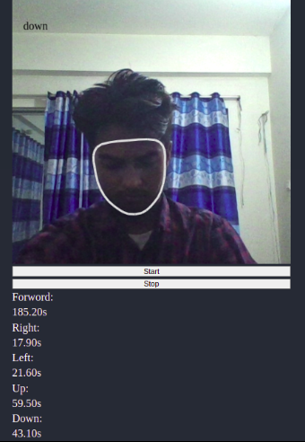
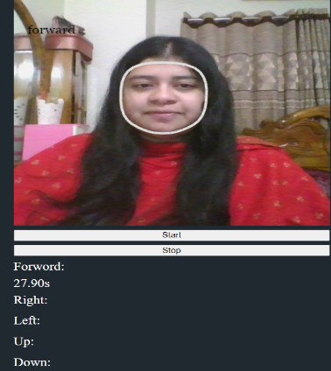
Result & Synthesis
Fig 6: Down face detection from 2 feet distance of different people
Fig 7: Forward face detection from 2 feet distance of different people

Slide 14
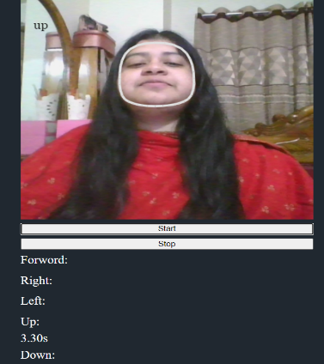
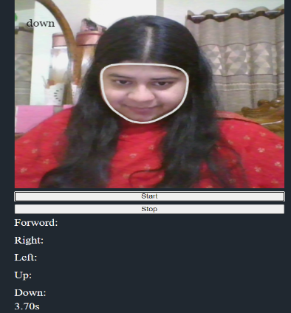
Result & Synthesis
Fig 8: Up face detection from 2 feet distance of different people
Fig 9: Down face detection from 2 feet distance of different people

Slide 15
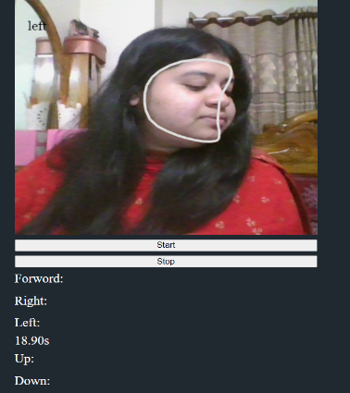
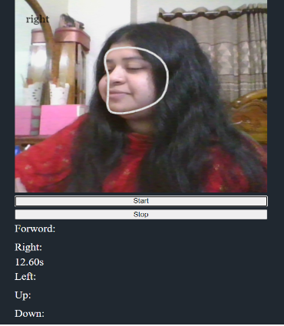
Result & Synthesis
Fig 10: Left face detection from 2 feet distance of different people
Fig 11: Right face detection from 2 feet distance of different people

Slide 16
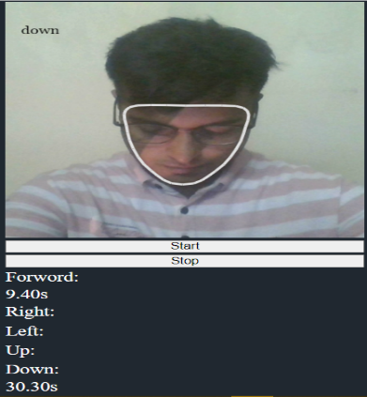
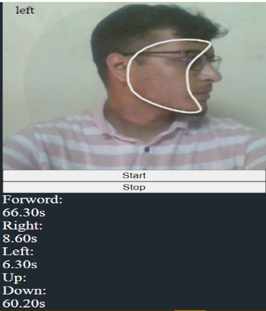
Result & Synthesis
Fig 12: Down face detection from 2 feet distance of different people
Fig 13: Left face detection from 2 feet distance of different people

Slide 17
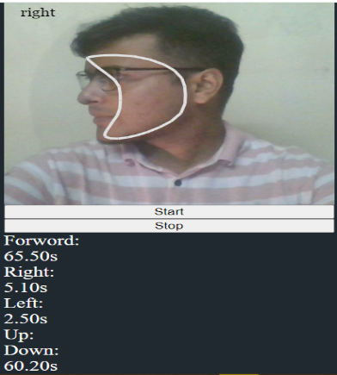
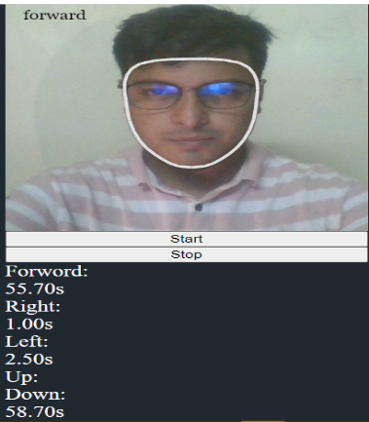
Result & Synthesis
Fig 14: Right face detection from 2 feet distance of different people
Fig 15: Forward face detection from 2 feet distance of different people

Slide 18
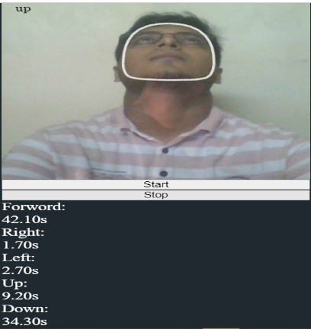
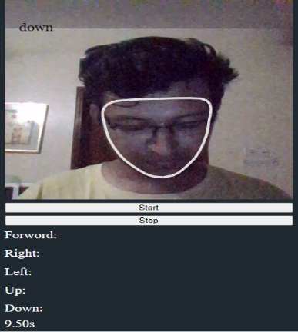
Result & Synthesis
Fig 16: Up face detection from 2 feet distance of different people
Fig 17: Down face detection from 2 feet distance in low light condition

Slide 19
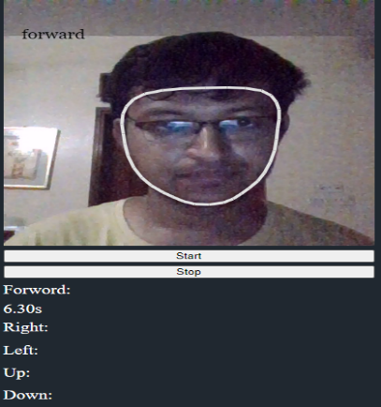
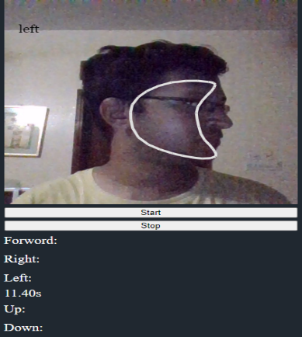
Result & Synthesis
Fig 18: Forward face detection from 2 feet distance in low light condition
Fig 19: Left face detection from 2 feet distance in low light condition

Slide 20
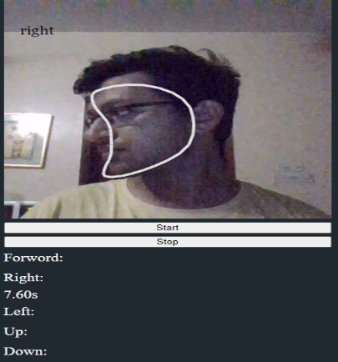
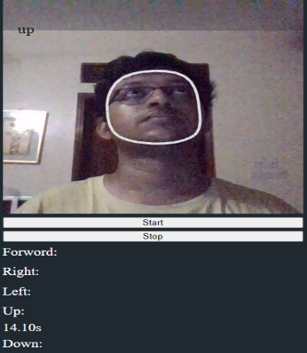
Result & Synthesis
Fig 20: Right face detection from 2 feet distance in low light condition
Fig 21: Up face detection from 2 feet distance in low light condition

Slide 21
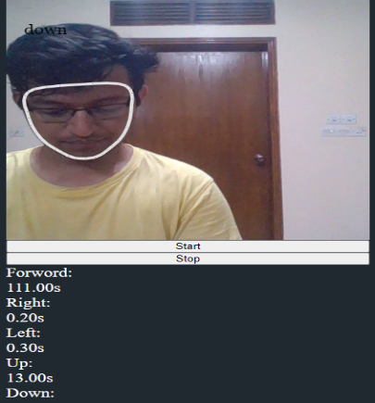
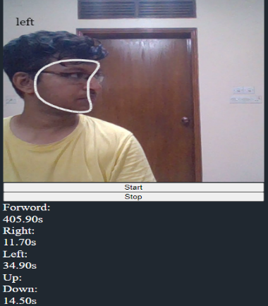
Result & Synthesis
Fig 22: Down face detection from 2 feet distance and different seating position
Fig 23: Left face detection from 2 feet distance and different seating position

Slide 22
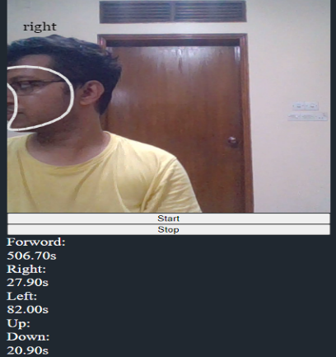
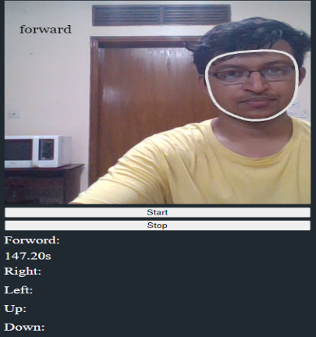
Result & Synthesis
Fig 24: Right face detection from 2 feet distance and different seating position
Fig 25: Forward face detection from 2 feet distance and different seating position

Slide 23
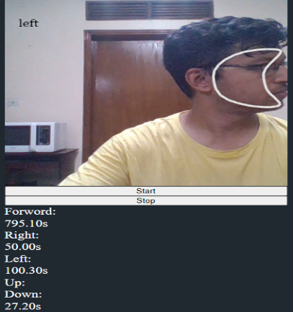
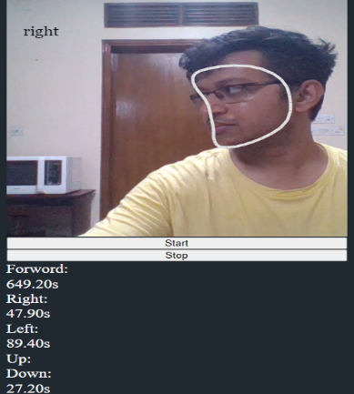
Result & Synthesis
Fig 26: Left face detection from 2 feet distance and different seating position
Fig 27: Right face detection from 2 feet distance and different seating position

Slide 24
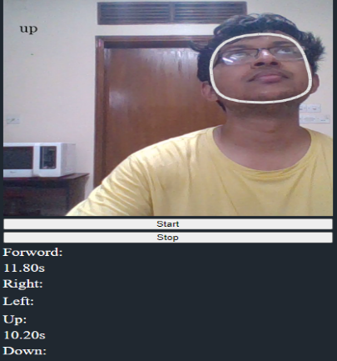
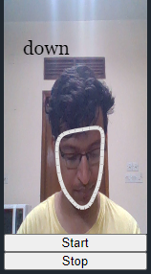
Result & Synthesis
Fig 28: Up face detection from 2 feet distance and different seating position
Fig 29: Down face detection from 2 feet distance and different window size

Slide 25
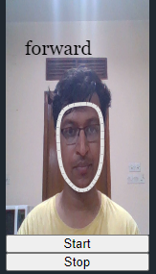
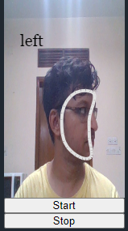
Result & Synthesis
Fig 30: Forward face detection from 2 feet distance and different window size
Fig 31: Left face detection from 2 feet distance and different window size

Slide 26
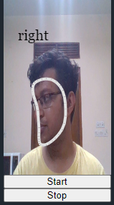
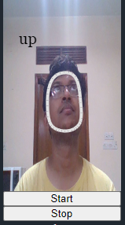
Result & Synthesis
Fig 32: Right face detection from 2 feet distance and different window size
Fig 33: Up face detection from 2 feet distance and different window size

Slide 27
Result & Synthesis
From 4 feet distance, different seating position, different window size and minimum face detecting lighting condition, the solution provided 88% forward, 87% left, 83% right, 86% up and 75% down detection accuracy. Table 2 shows the details analysis.
Table 2: Break down of the analysis of the result from 4 feet distance, different seating position,
different window size and minimum face detecting lighting condition
Side | Actual | Solution output | Accuracy
Forward | 100 times | 88 times | 88%
Right | 100 times | 83 times | 83%
Left | 100 times | 87 times | 87%
Up | 100 times | 86 times | 86%
Down | 100 times | 75 time | 75%

Slide 28
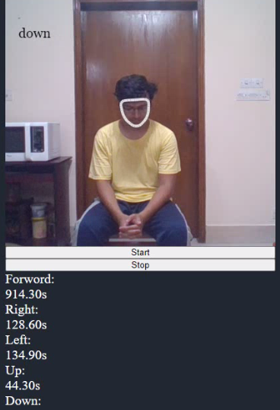
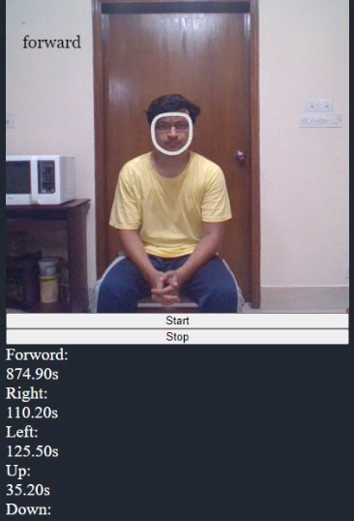
Result & Synthesis
Fig 34: Down face detection from 4 feet distance and different seating position
Fig 35: Forward face detection from 4 feet distance and different seating position

Slide 29

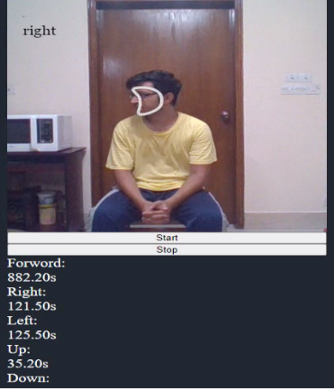
Result & Synthesis
Fig 36: Left face detection from 4 feet distance and different seating position
Fig 37: Right face detection from 4 feet distance and different seating position

Slide 30
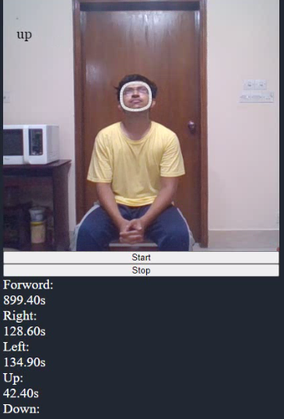
Result & Synthesis
Fig 38: Up face detection from 4 feet distance and different seating position

Slide 31
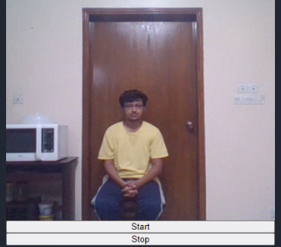
Result & Synthesis
Our proposed solution fails to detect the face orientation from distance more than 4 feet as the face and facial land mark detection is quite difficult from such distance.
Fig 39: Fails to detect face from more than 4 feet distance

Slide 32
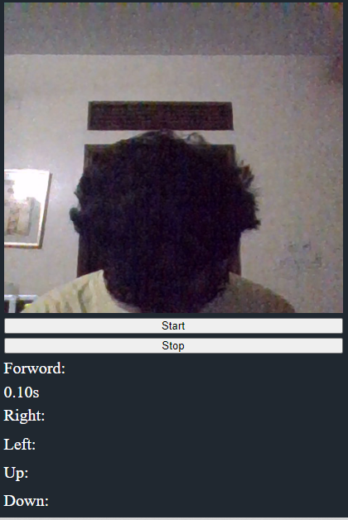
Result & Synthesis
If the nose is not visible then the proposed solution also fails to detect the face orientation
Fig 40: Face movement detection is not possible as nose is not visible

Slide 33
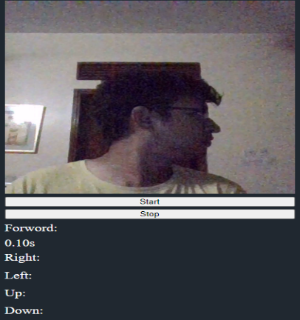
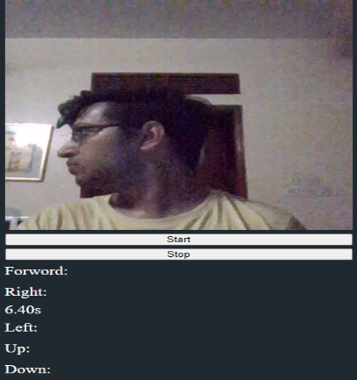
Result & Synthesis
Fig 41: Face movement detection is not possible as nose is not fully visible
Fig 42: Face movement detection is not possible as nose is not fully visible

Slide 34
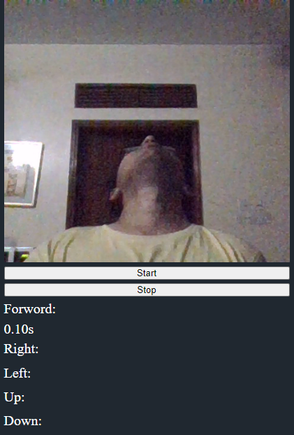
Result & Synthesis
Fig 43: Face movement detection is not possible as nose is not fully visible

Slide 35
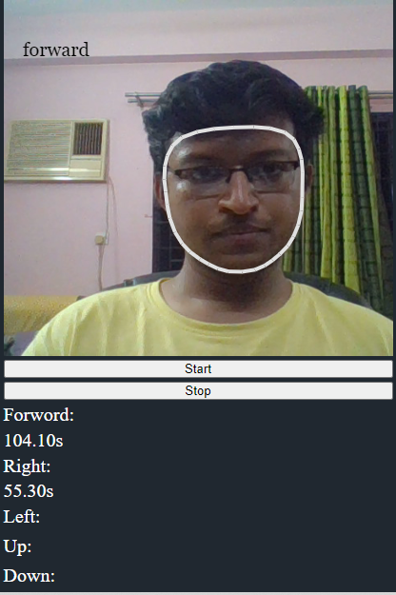
Result & Synthesis
The proposed solution can also detect the time duration with 95% accuracy
Fig 44:Face movement detection with timer

Slide 36
Future work
Will try to increase the accuracy of face movement detection from more than 4 feet distance
Will try to make the face movement detector more dynamic so that it can detect the face movement from every possible angle with accuracy

Slide 37
References
Gao, L., & Xu, Y. (2012). Face orientation recognition based on multiple facial feature triangles. 2012 International Conference on Control Engineering and Communication Technology. https://doi.org/10.1109/iccect.2012.175
Gupta, K. D., Ahsan, M., Andrei, S., & Alam, K. M. R. (2017). A robust approach of facial orientation recognition from facial features. BRAIN. Broad Research in Artificial Intelligence and Neuroscience, 8(3), 5-12. https://www.brain.edusoft.ro/index.php/brain/article/view/705
Merrouche, F., & Baha, N. (2017, July). Fall detection using head tracking and centroid movement based on a depth camera. In Proceedings of the International Conference on Computing for Engineering and Sciences (pp. 29-34). https://dl.acm.org/doi/abs/10.1145/3129186.3129192
Shah, H. M., Dinesh, A., & Sharmila, T. S. (2019). Analysis of facial landmark features to determine the best subset for finding face orientation. 2019 International Conference on Computational Intelligence in Data Science (ICCIDS). https://doi.org/10.1109/iccids.2019.8862093

Slide 38
References
Takeda, K., & Otsuka, K. (2021). Inflation-deflation networks for recognizing head-movement functions in face-to-face conversations. Proceedings of the 2021 International Conference on Multimodal Interaction. https://doi.org/10.1145/3462244.3482856
Wang, H., Jin, T., & Zhang, Y. (2020). Application of IAFSA-BP neural network in face orientation recognition. Journal of Physics: Conference Series, 1651(1), 012137. https://doi.org/10.1088/1742-6596/1651/1/012137
Xia, X., Xu, C., & Nan, B. (2017). Facial expression recognition based on TensorFlow platform. ITM Web of Conferences, 12, 01005. https://doi.org/10.1051/itmconf/20171201005
Yuan, L., Qu, Z., Zhao, Y., Zhang, H., & Nian, Q. (2017). A convolutional neural network based on TensorFlow for face recognition. 2017 IEEE 2nd Advanced Information Technology, Electronic and Automation Control Conference (IAEAC). https://doi.org/10.1109/iaeac.2017.8054070
Zhang, H., Gu, Y., & Kamijo, S. (2019). Orientation and occlusion aware multi-person pose estimation using multi-task deep learning network. 2019 IEEE International Conference on Consumer Electronics (ICCE). https://doi.org/10.1109/icce.2019.8662041

Slide 39
Proposed System
Live Demo Link

